Slide 1
L4/L5 Group 3
Elliot Chester
Matthew Fisher
Lenneth Dayaon
Adam Speers

Slide 2
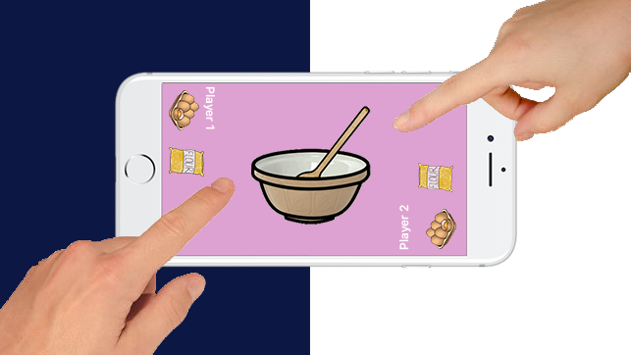
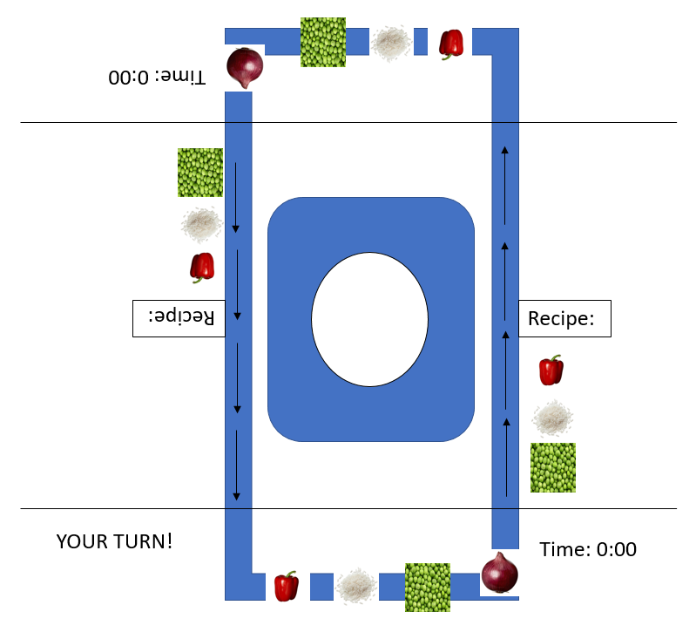
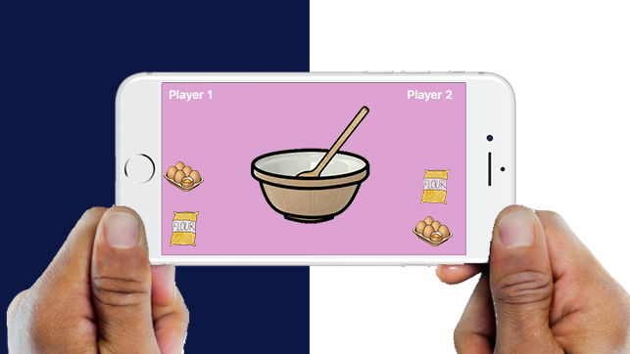
Our Ideas
We had many ideas that we have narrowed down to these
2D Cooking Game
Turn-based Adversary Multiplayer
Tap to pick ingredient
Select ingredients and follow the recipe
Players to will scored on completion time and difficulty of recipe
Symmetric Gameplay
Notes:
Matthew
We’ve gone through many ideas for our game, we’ve managed to refine it down to 2 final ideas which are similar but feel very different to play.
Both ideas are 2D cooking games, each player will take turns looking at a recipe and remembering which ingredients are needed.
Players will be scored on how much they manage to remember and how long it took them to make their food.
The game will be symmetric so that each player gets an even playing field

Slide 3
Idea 1
Ingredients are on a moving conveyer belt
Players must remember their required ingredients
Players take turns picking ingredients
More score for speed
Recipes will have different ingredients and completion times.
If time runs out you fail
Notes:
Elliot
The ingredients are on a moving conveyer belt, constantly rotating.
Players must select their required ingredient while the conveyer belt is moving.
One player gets one ingredient then the other player the next ingredient, this process goes on until they complete the recipe
Players must complete the recipe, the quicker the completion of the recipe, the better the score.
Each recipe will have different ingredients and different completion times.
Game will end if the players cannot complete the recipe in the required time.

Slide 4
Idea 2
Ingredients are shown on each side of the screen
Players must select their required ingredients
Players take turns picking ingredients
More score for speed
Recipes will have different ingredients and completion times.
If time runs out you fail
Simpler and less confusing that Idea 1
Notes:
Elliot
The ingredients are on a moving conveyer belt, constantly rotating.
Players must select their required ingredient while the conveyer belt is moving.
One player gets one ingredient then the other player the next ingredient, this process goes on until they complete the recipe
Players must complete the recipe, the quicker the completion of the recipe, the better the score.
Each recipe will have different ingredients and different completion times.
Game will end if the players cannot complete the recipe in the required time.

Slide 5


Target Audience
Mobile Casual Gamers
Gender: Female
Age: 21-35
60-70% of the current market
21-35
Notes:
Lenneth
After doing some research we have decided to set our target audience as casual gamers.
We will target our game towards women aged 21 – 35 years old, we’ve chosen these people because they are 60 – 70% of the current market within the style of game we have chosen.

Slide 6
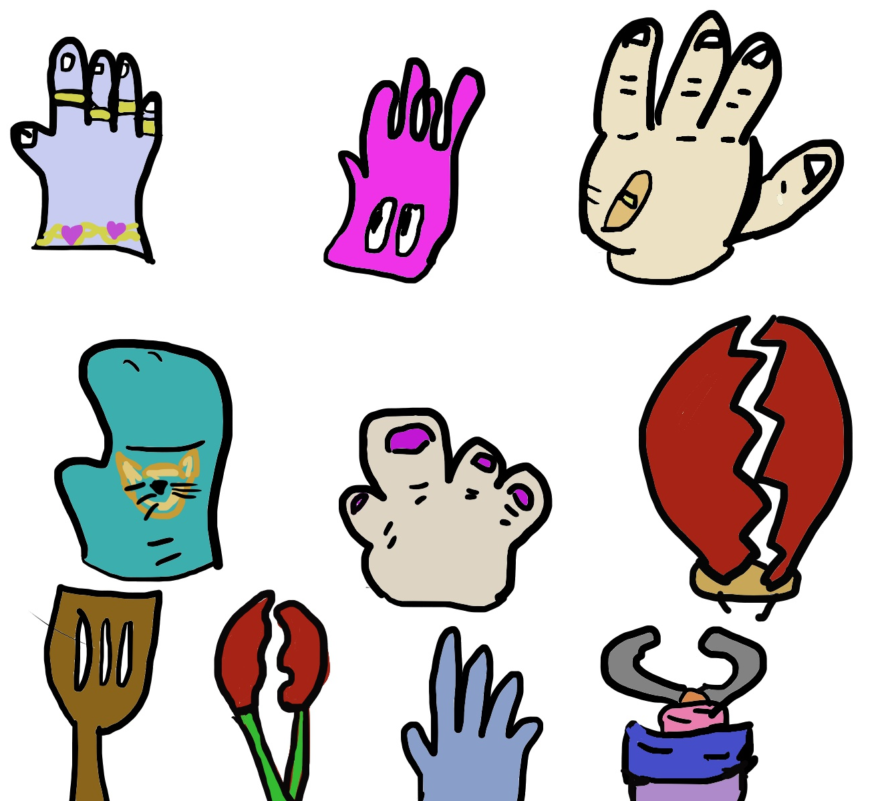
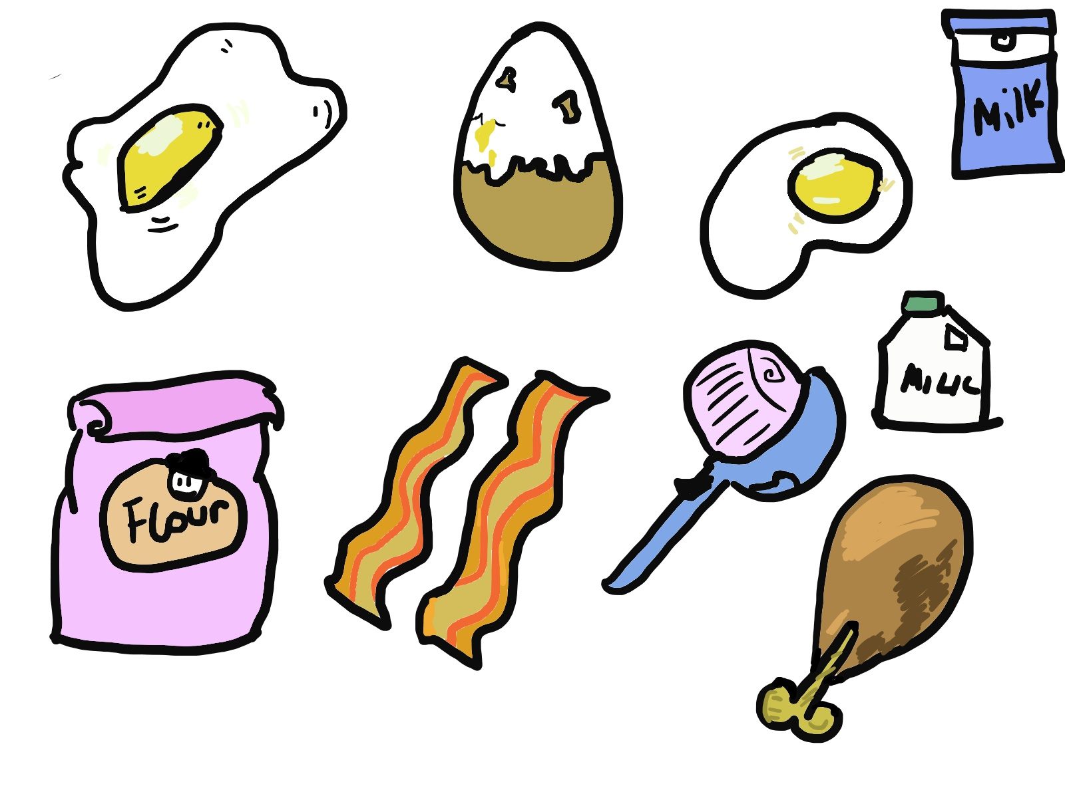
Art Style
Cartoon Style
Cell Shaded Graphics
Notes:
Lenneth
For our art style we have chosen to go with cartoony cell shaded graphics, this is because this is what connects with our target audience best and keeps each item easy to recognise at a glance.

Slide 7
Optimising for Mobile
Use Icons rather than text
Buttons must not be too small
Screen orientation must be best for 2 players
Notes:
Adam
Mobile and desktop have very different sized screens, there are some things we have to do to optimise our game for mobile and our casual style of game.
We should use icons rather than text where possible, this makes it easier for the player to know what they have to tap on and what they have to read.
Buttons that may seem like an acceptable size on a desktop or laptop, may look tiny on a mobile screen so we have to make sure that all of the buttons are the correct size for the screen we will be using.
Our game will be multiplayer, which means we have to think about how things are laid out on the screen. Portrait orientation with each player facing the screen. Landscape orientation with player sitting next to each other. We will have to experiment with these 2 layouts and create prototypes to see which is best for our game.

Slide 8
Any Questions?

